Slide 1
Modules and Namespaces
Cheltenham Hackspace Python Course
Week 9

Slide 2
What is a namespace
“For many programming languages, namespace is a context for their identifiers” - https://en.wikipedia.org/wiki/Namespace#In_programming_languages
In python identifiers can be anything that we give a name for example:
Variable – When we define a variable we add that to a namespace so that it can be referenced later
Function – When we create a function we add that to a namespace
When we start a python program the interpreter has a “default namespace”
This can be viewed using the dir() command

Slide 3
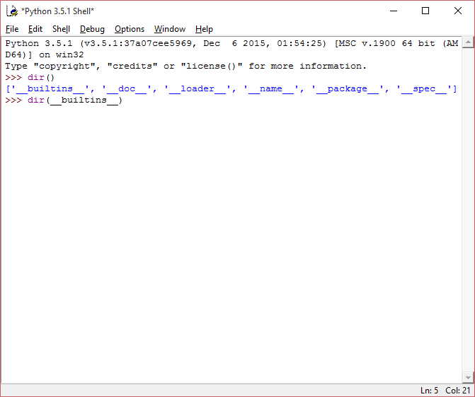
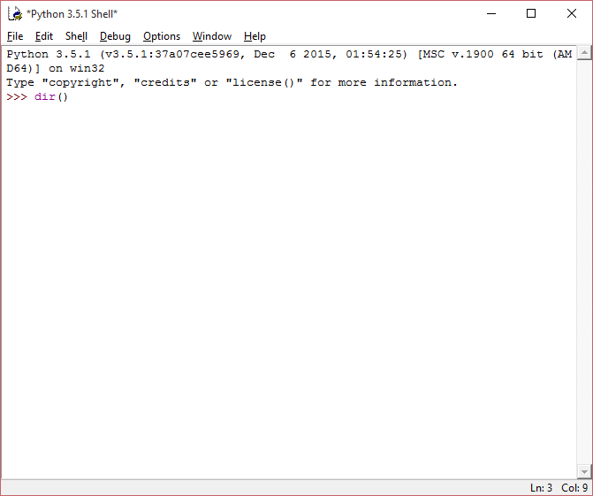
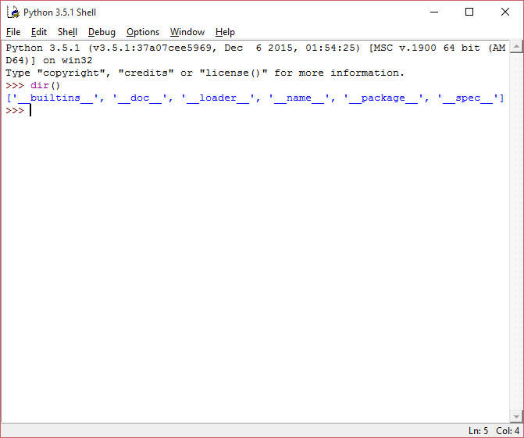
Default namespace – Interactive exercise
Start idle and run the dir command.
This shows all “names” within namespace.
The “__builtins__” module contains all the built in functions and variables.
Run dir(__builtins__)

Slide 4
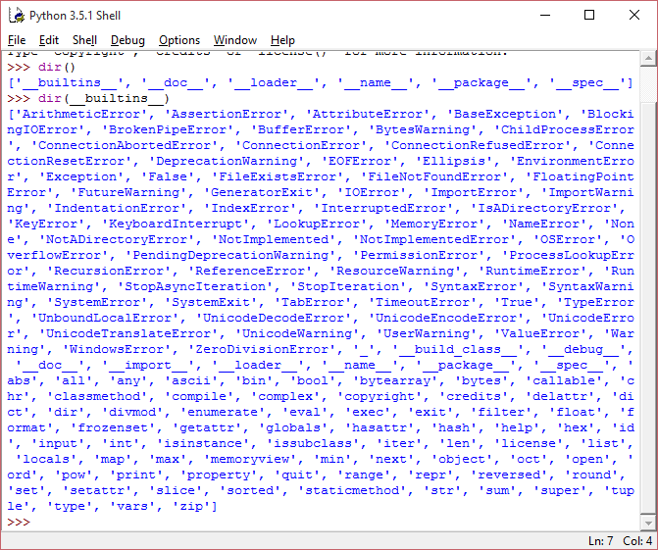
Default namespace – Interactive exercise
Here you will see the functions (and variables) that are available by default.
For example
print – write output to screen
len – find the length
open – Open a file

Slide 5
Namespaces
A namespace is simply a collection of available names
When we import a module we “include” it within the namespace
Initially a namespace can be considered to be empty and the __builtin__ modules are imported into the namespace.
For example:

Slide 6
Initial state
Importing
Imported
Default Namespace
__builtins__
__builtins__
print
dir
Import __builtins__
len
open

Slide 7
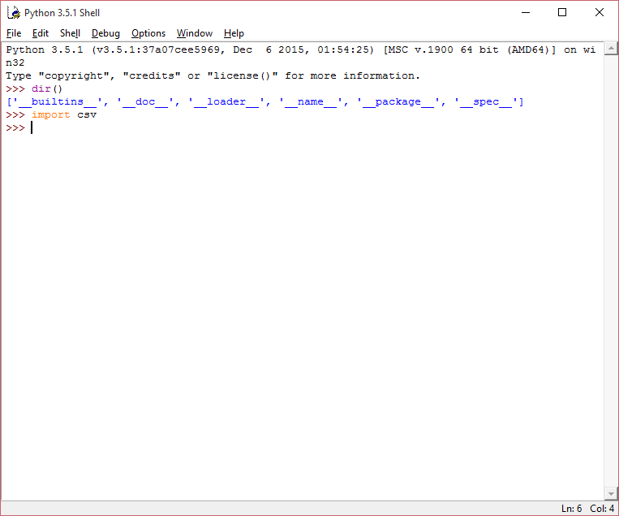
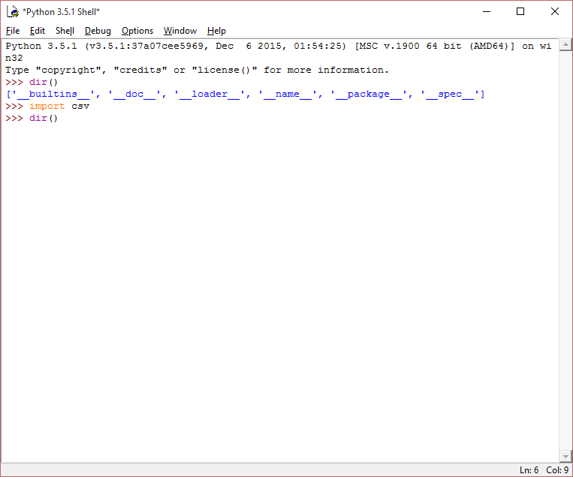
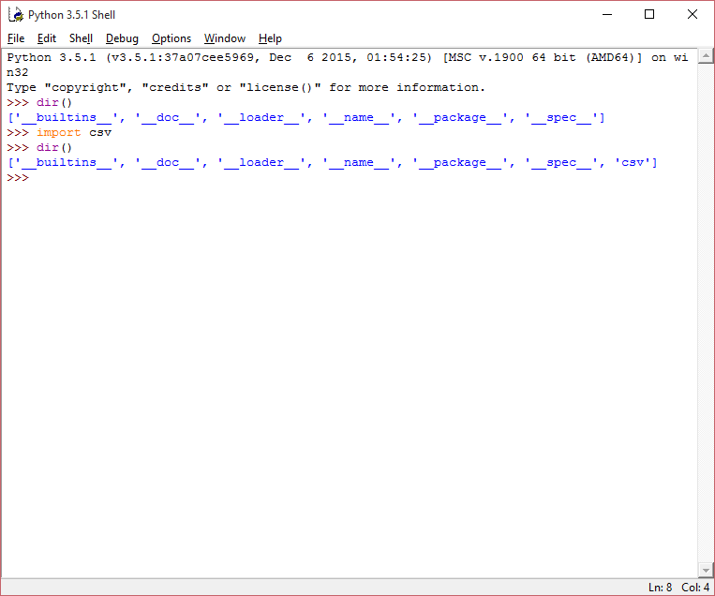
Import module– Interactive exercise
Import the module (csv) that we used last week
Run the dir command again
You will see that csv has been imported into the default namespace

Slide 8
Initial state
Importing
Imported
Default Namespace
csv
__builtins__
csv
Import csv
Only the variables/functions within __builtins__ are available without qualifying with the module name
i.e. to access variables/functions within csv, you must use csv.<variable>

Slide 9
Importing – Alternative syntax
There is an alternative method to importing:
from <module_name> import *
This imports all of the names within the module into the default namespace
Therefore you do not need to qualify a call to a variable/function.

Slide 10
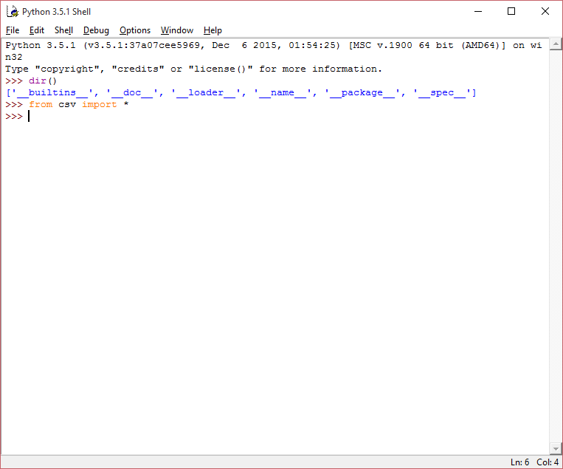
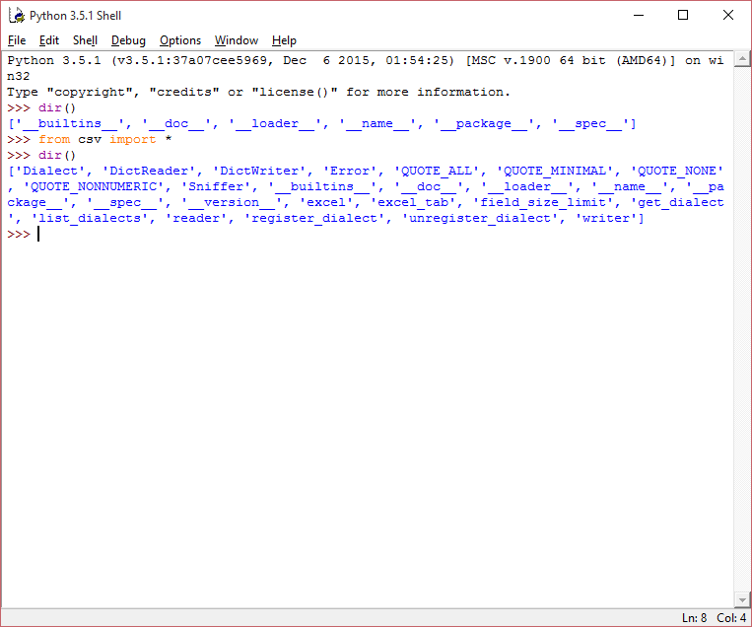
Import module– Interactive exercise
Starting from a new idle session
Run from csv import *
Run the dir command again
You will see that all of the functions/variables from csv are now imported into the default namespace

Slide 11
Import module – Alternative syntax
Great I hear you say – I can just use <variable> instead of <module>.<variable>
The problem with this approach is that it will override any items already in the namespace without warning

Slide 12
Default Namespace
module1
__builtins__
From module1 import *
dosomething()
dosomething()
dosomething()
doanother()
doanother()
dofinal()
dofinal()
do ()
module2
doother()
From module2 import *
dosomething()
do ()
doother()

Slide 13
Modules – How to define
A module is a simple python file (ending in .py)
Just write code without a “main” flow.
i.e. you will just define classes/functions/variables but not actually run them.

Slide 14
Modules – Where to find
Python will look for modules in the following locations
The folder from which the python interpreter was launched.
Any folder defined within the sys.path variable
The sys.path variable can be added to dynamically at run time or the PYTHONPATH system variable can be set.

Slide 15
Packages
Packages are used for structuring modules by use of dotted module names
For example:
A.B designates a sub-module B in package A
In python packages are just directories
A sub package is also a sub directory
Each package (and sub package) must have a __init__.py file (this file can be empty).
This tells python that the containing directory is a package

Slide 16
Packages – Example
This example is taken from the python documentation.
Lets imaging that we have a collection of modules that allow us to provide uniform handling of audio files.
There are various file types (.wav, .mp3, .au etc).
There are also various operations that we may want to do on these files (mixing, adding echo, adding stereo effect).
To collect these together we may create a package called sounds.
The next slide gives an example of how this may be structured

Slide 17
Packages - Example
sound/ ← Top-level package
__init__.py ← Initialize the sound package
formats/ ← Subpackage for file format conversions
__init__.py
wavread.py
wavwrite.py
mp3read.py
mp3write.py
effects/ ← Subpackage for sound effects
__init__.py
echo.py
surround.py
reverse.py
filters/ ← Subpackage for filters
__init__.py
equalizer.py
vocoder.py
karaoke.py
To load the wavwrite module one would use the following import statement:
import sound.formats.wavwrite
It is also possible to import submodules directly to the default namespace using:
from sound.formats import wavwrite
But the normal considerations should be taken into account when performing this

Slide 18
Packages – __init__.py file
As mentioned previously the __init__.py file can be empty.
However, if you have multiple sub modules there is a gotcha with the following import statement:
from sound.effects import *
This will not import all sub modules.
To do this you need define the __all__ variable in the __init__.py file. For example if we wanted to import all the modules in the above statement we would have to add the following to the sound/effects/__init__.py file:
__all__ = [“echo”, “surround”, “reverse”]

Slide 19
Exercise
Create your own package/module.
You can chose:
Implement your own package
Implement a package that contains modules to provide the “8-ball” functionality
Bonus points* will be awarded for use of objects
Tip: to read a string from command line you can use the input function
E.g. s = input(); # s will contain the input
If you are using python 2 the function is raw_input()
*points are for fun and in this case by exception do not mean prizes ☺

